Slide 1
Kubernetes

Slide 2
Why we need container orchestration tool?
If an organization is running large scale of container, then it would be difficult to manage them.
Scaling and scheduling those numbers of containerized applications at large scale would be difficult to manage.
This brings the necessity of container orchestration tools.

Slide 3
What is Container Orchestration Engine
It is a tool to manage the scaling, deploying and scaling the containerized app on a group of server.
The main purpose of a container orchestration tool is to clustering and schedule container to a cluster.

Slide 4
Top 3 container orchestration tools
Kubernetes
Docker swarm
Marathon
Cloud specific container service

Slide 5
Features of COE
Clustering
Scheduling
Scaling
Load Balancing
Fault Tolerance
Deployments

Slide 6
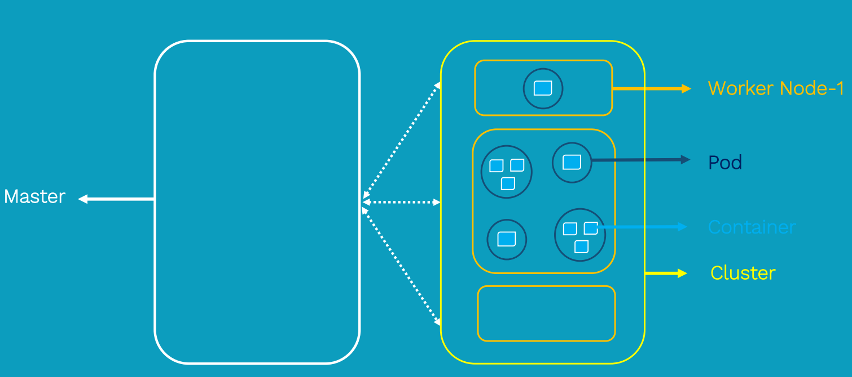
Kubernetes architecuture

Slide 7
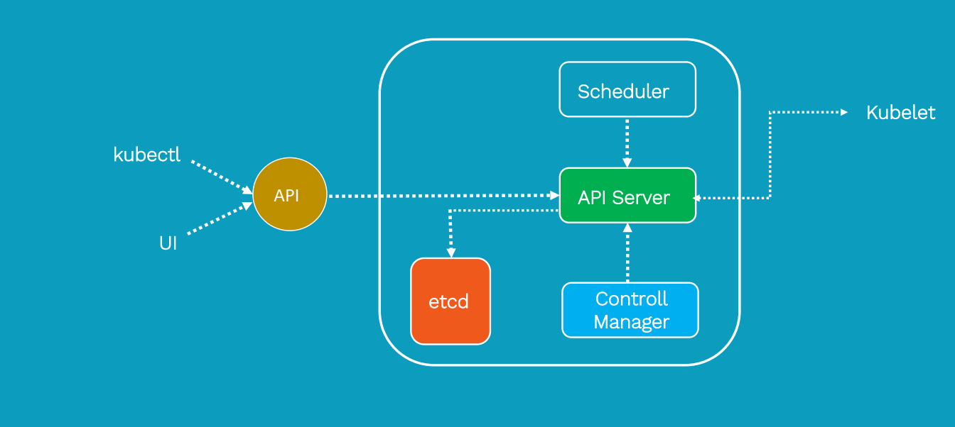
Kubernetes master components

Slide 8
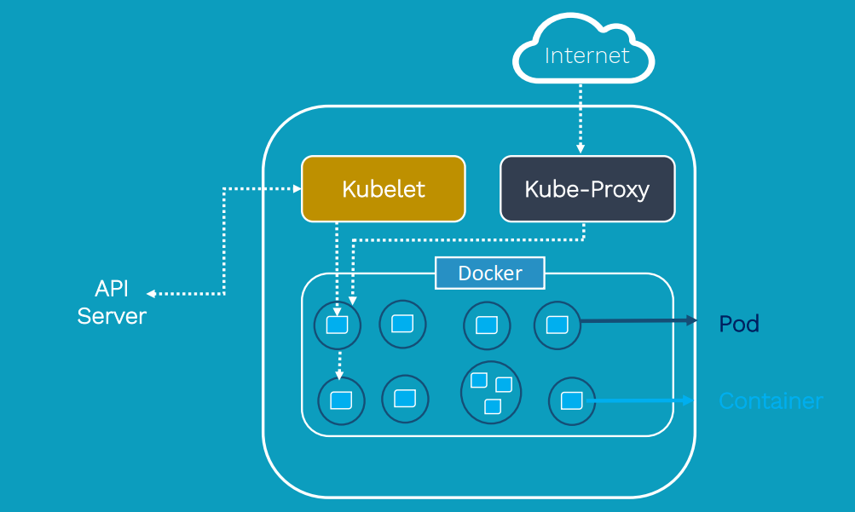
Worker nodes components

Slide 9
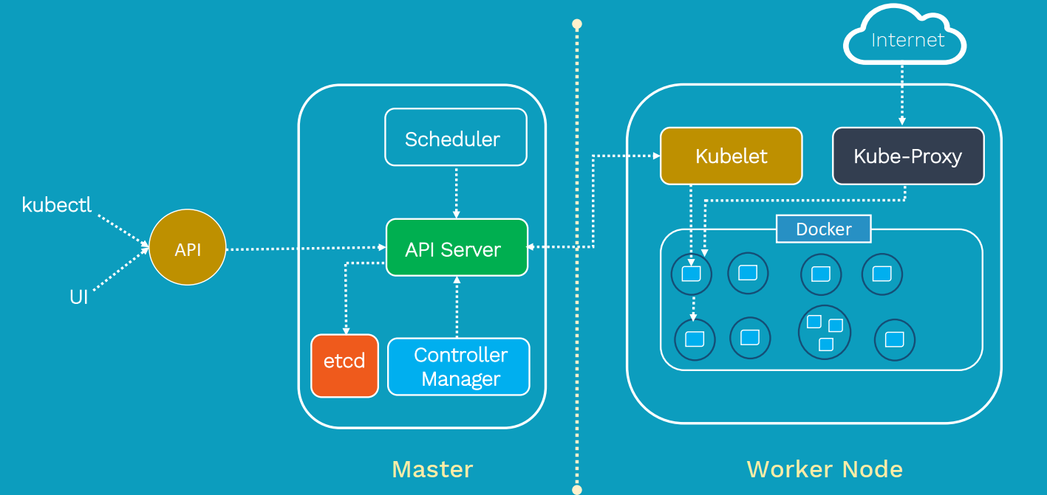

Slide 10
Kubernetes Installation
There are various ways we can start working with Kubernetes.
Play-with-Kubernetes
Minikube
Configuration from scratch on servers

